Slide 1



(Affiliated to JNTUK Kakinada & Approved by AICTE, New Delhi, Accredited by NAAC)
Surampalem, ADB road, East Godavari District AP-533437

Slide 2
PHARMACY MANAGEMENT SYSTEM
TEAM MEMBERS
Name Rollno
U . Tarun Pavan Kumar 21MH1A05D0
P . Kalyani Reddy 21MH1A05B8
G . Harshitha 21MH1A0593
M . Sanjana 21MH1A05B2

Slide 3
ABSTRACT
The Pharmacy Management System is a comprehensive Java Swing-based project designed to enhance the efficiency of pharmacy operations. This system features a user-friendly interface, providing tools for user management, precise control over medicine inventory, and streamlined billing processes. Leveraging Java Swing for an intuitive graphical interface and MySQL for robust data management, PMS enables pharmacists to easily add, update, or remove medicines. The system generates detailed bills in PDF format, contributing to improved record-keeping and accessibility. The primary objective is to minimize manual efforts, reduce errors, and elevate the accuracy of pharmacy operations.

Slide 4
INTRODUCTION
Pharmacy Management is a Java-based project integrated system designed for efficient management within a pharmacy environment. It introduces two distinct user roles, administrators and pharmacists, each with specialized responsibilities. Administrators have the privilege to create, view, and modify user profiles, including role assignments. Pharmacists, on the other hand, can seamlessly handle pharmaceutical inventory operations, encompassing tasks like adding, viewing, and selling medicines, alongside automated bill generation. This project leverages the power of Java to provide a cohesive and user-friendly platform for enhanced administration and operation control within a pharmacy setting."

Slide 5
Technologies
Java Programming:
The core logic and functionality of the project are implemented using the Java programming language, ensuring cross-platform compatibility and robust performance.
Java swing:
Java Swing is a part of the Java Foundation Classes (JFC) and provides a comprehensive set of GUI components, such as buttons, text fields, and windows, for building interactive and visually appealing desktop applications.
Java Database Connectivity (JDBC)
JDBC is a Java-based technology for connecting to and managing relational databases. You've used JDBC to interact with a MySQL database, enabling data storage, retrieval, and management.

Slide 6
Hardware Requirements
Processor: A modern multi-core processor (e.g., Intel Core i3 or AMD Ryzen 3) is recommended.
RAM (Random Access Memory): Minimum 4GB recommended, 8GB or more for improved performance.
Storage: Adequate disk space for development tools and JDK; 256GB or more recommended.
Operating System: Compatible with Windows, macOS, or Linux.

Slide 7
Software Requirements
IDE (Integrated Development Environment):
Use Eclipse or NetBeans for Java application development, and consider a code editor like Visual Studio Code (VS Code).
Java development kit (JDK):
you need the java development kit to compile and run java programs.
Swing Library:
Include Swing components and classes for building the graphical user interface (GUI) of your application.
JDBC (Java Database Connectivity):
Utilize JDBC for connecting your Java application to a MySQL database, ensuring the availability of necessary drivers and libraries.

Slide 8
Project Modules
User Authentication
Admin Management
Medicine Management
Billing Module

Slide 9
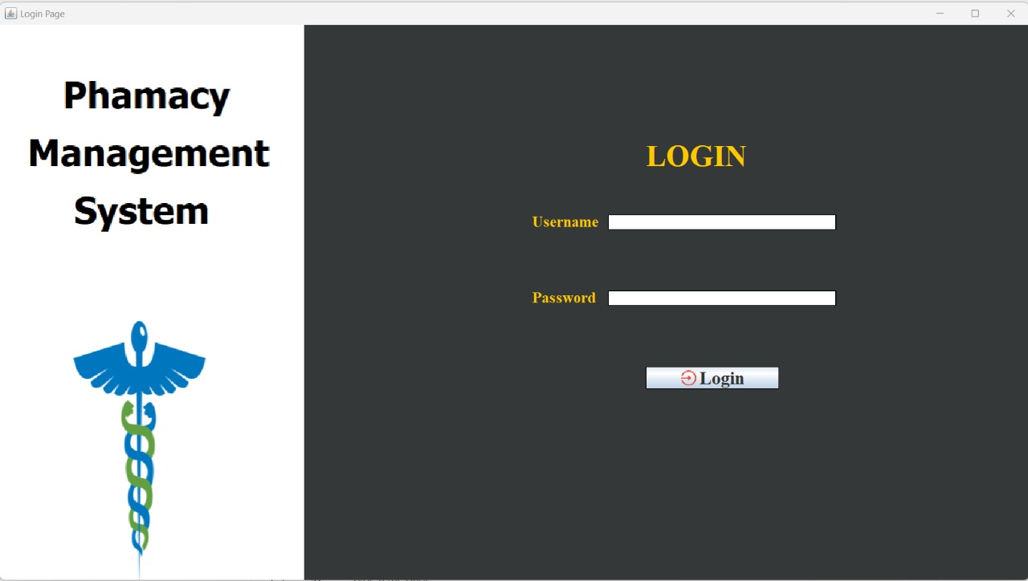
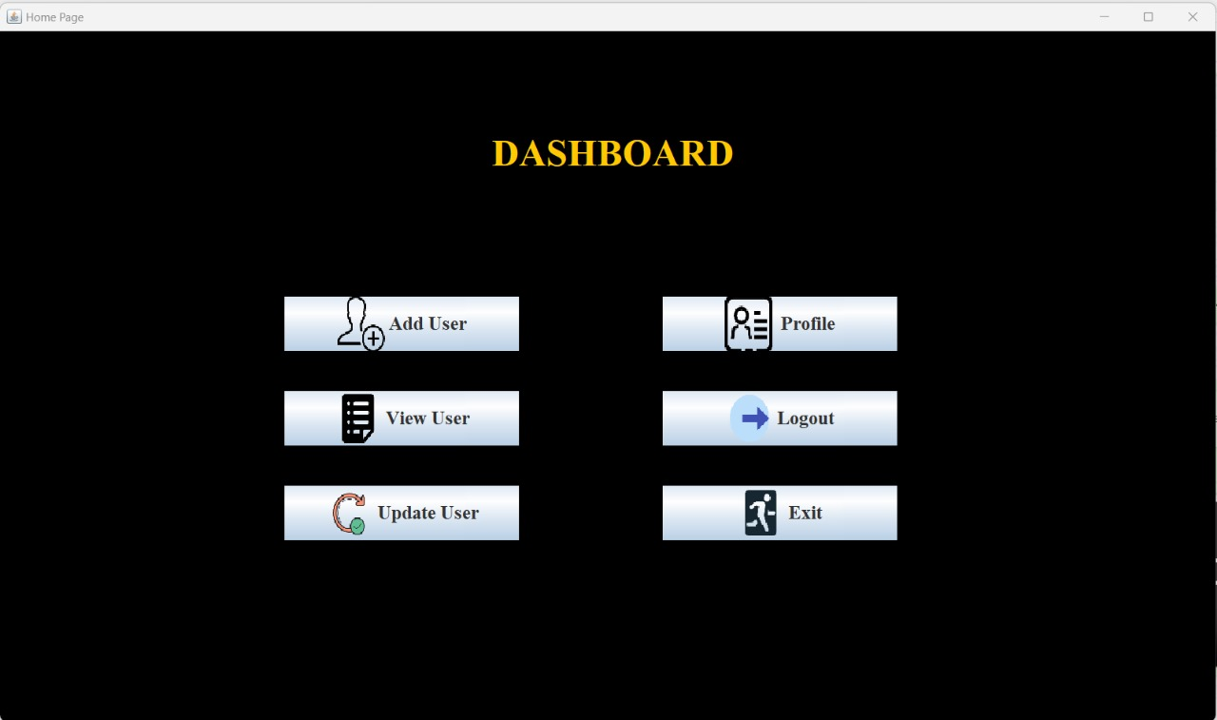
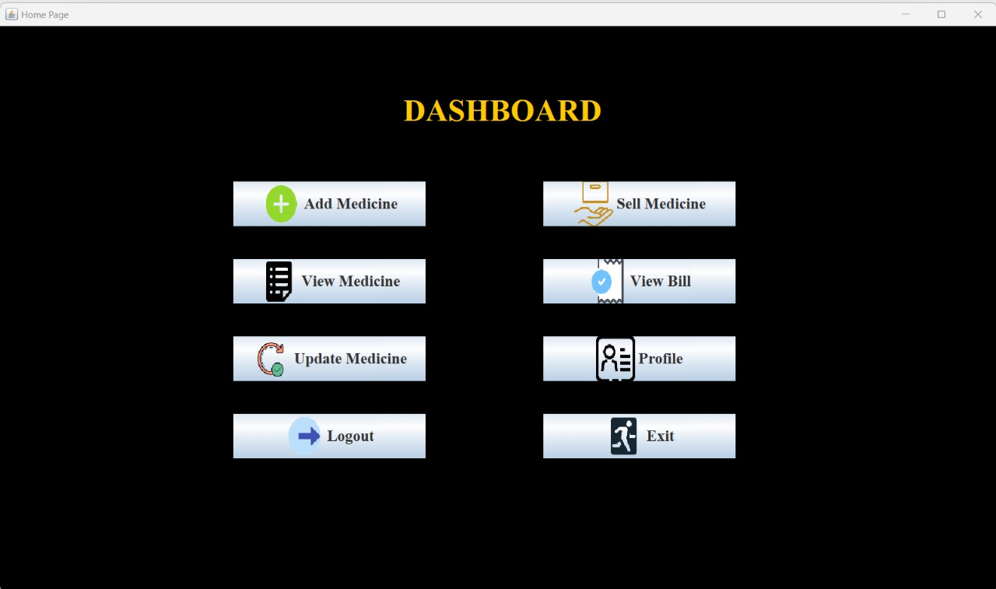
User Authentication :
The User Authentication module is crucial for safeguarding the system's data.
Features: Secure login for both administrators and staff. Password protection and encryption for enhanced security. User roles and permissions to control access.

Slide 10
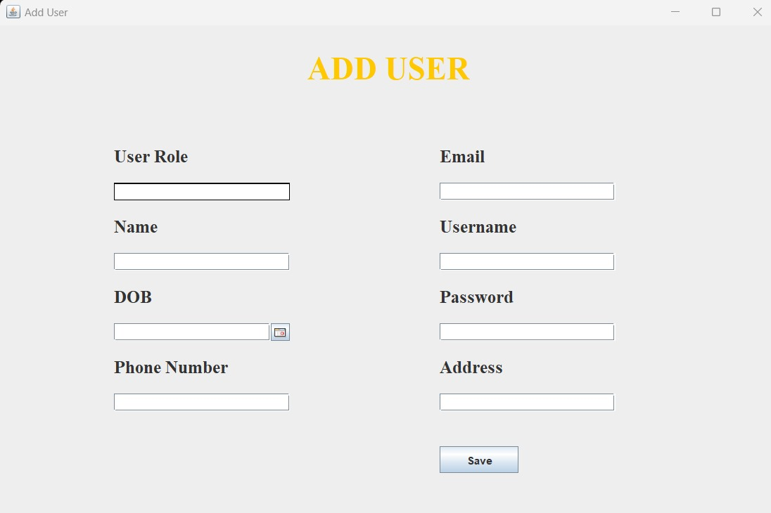
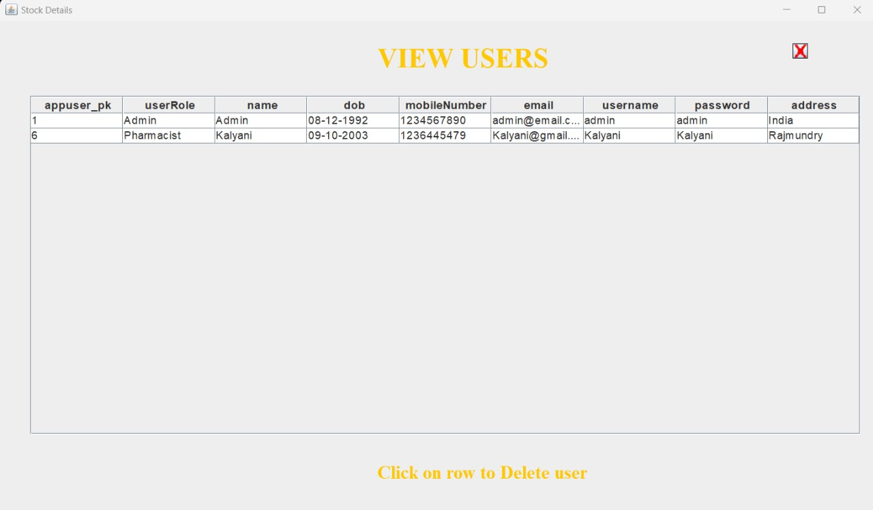
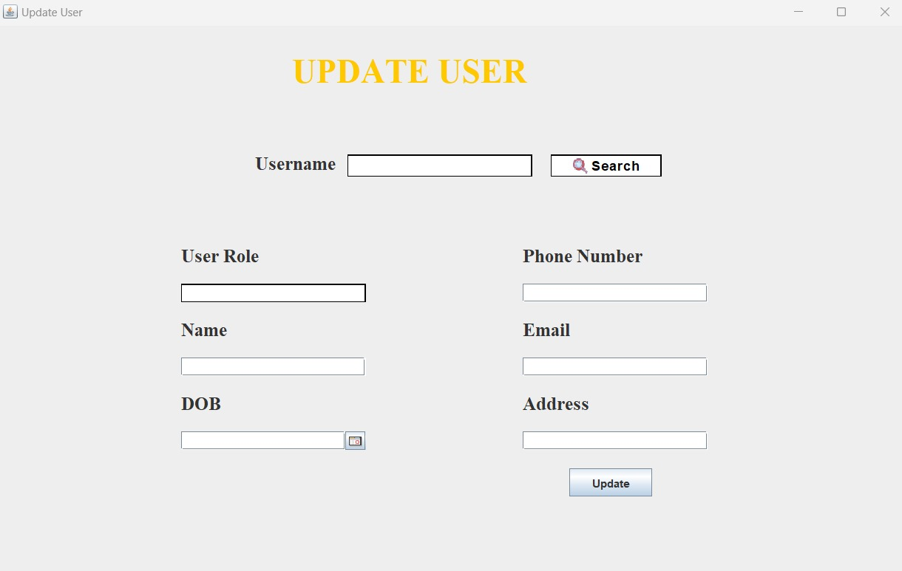
Admin Management Module:
It includes functionalities such as adding, viewing, updating user profiles, and accessing detailed user information.
Add User: - Enables the addition of new user profiles to the system i.e. pharmacist and admin.
View User: - Allows administrators to access and view user information.
Update User: - Permits the modification of user profiles for necessary updates.

Slide 11
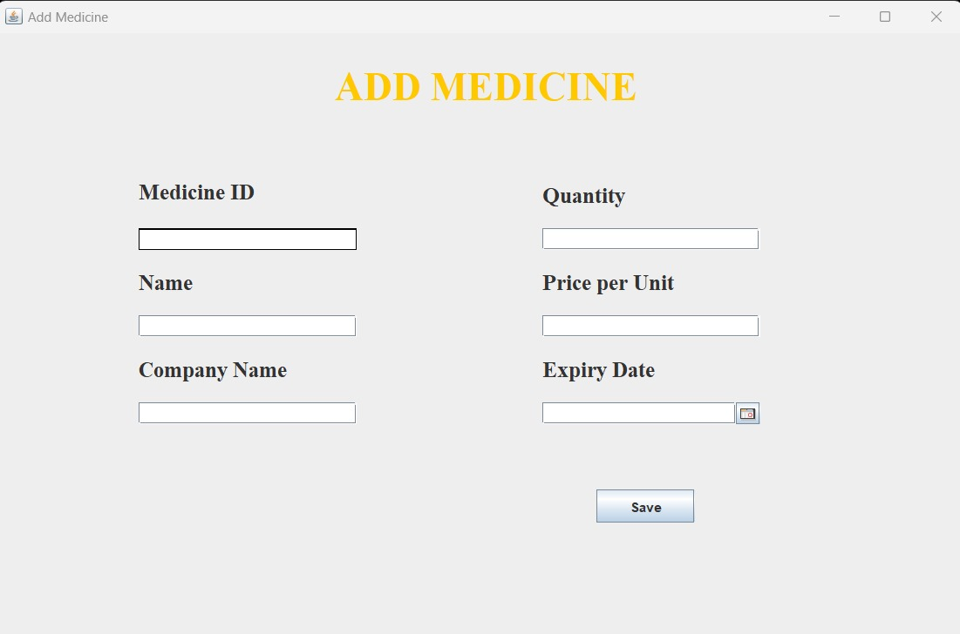
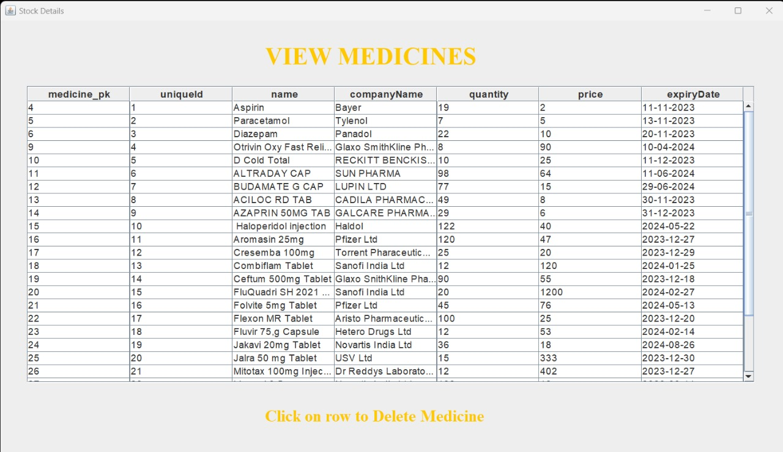
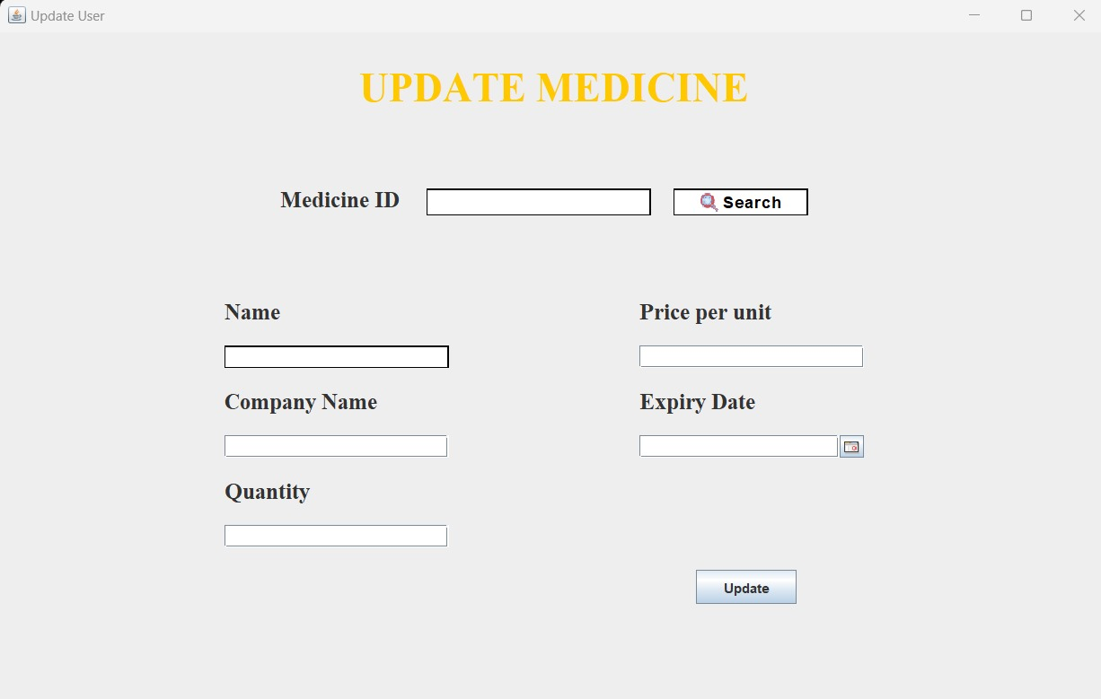
Medicine management:
Add Medicine: Facilitates the inclusion of new medicines into the system.
View Medicine: Provides a user-friendly interface to access and display medicine information.
Update Medicine: Allows for the modification of medicine details for necessary updates.

Slide 12
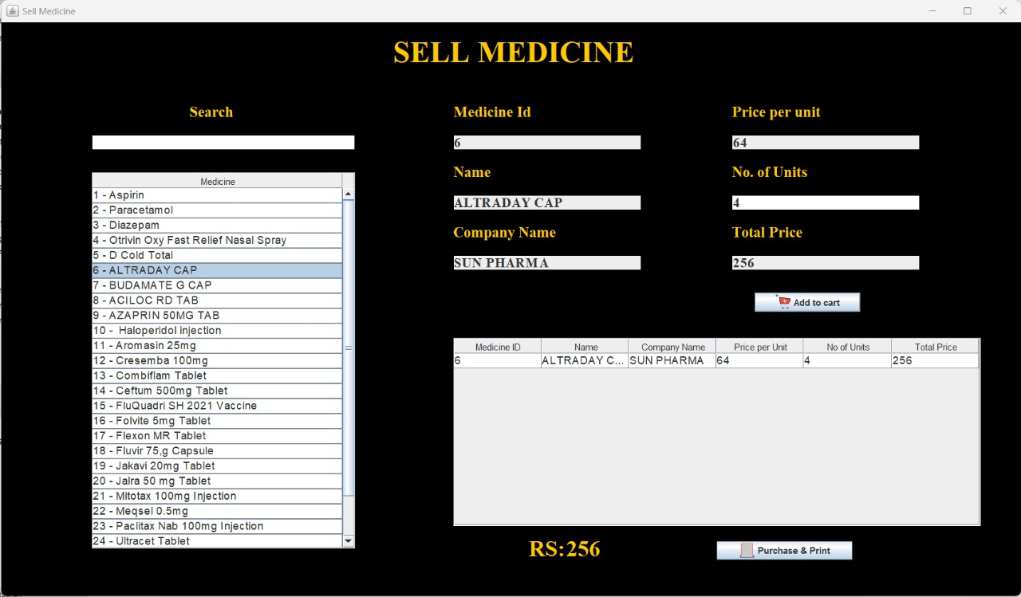
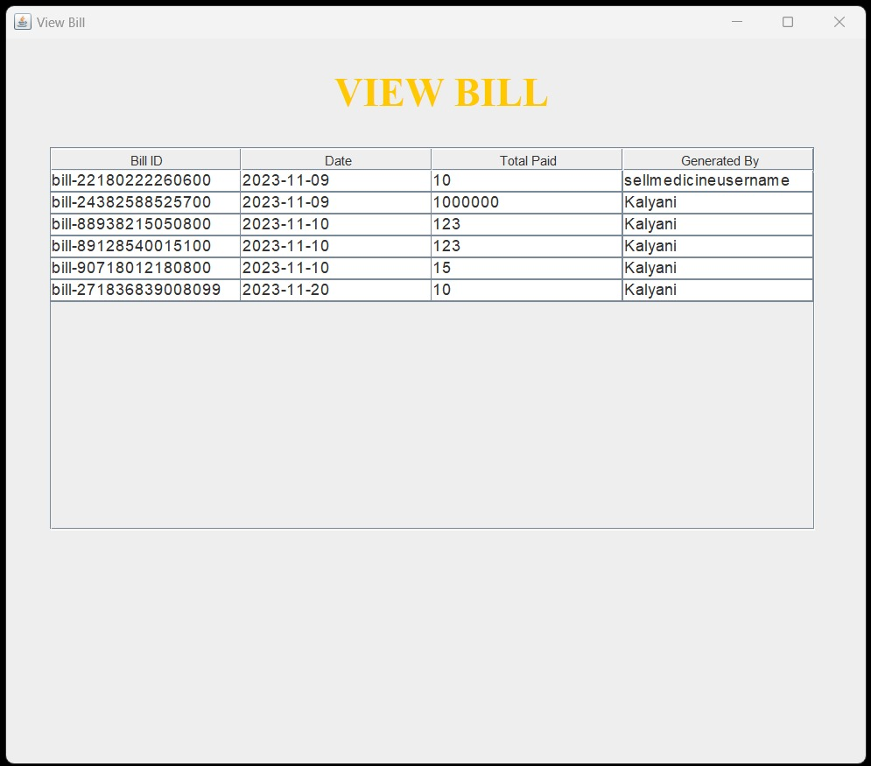
Billing Module:
Sell Medicine : Sell medicine facilitates the smooth transaction of medicines. It incorporates checks to ensure that only non-expired medicines are sold, promoting customer safety. Real-time stock verification prevents the sale of items not currently in stock, maintaining accurate inventory levels and a bill is generated after the purchase.
View Bill : View Bills module allows users to access and review a comprehensive list of generated bills, providing insights into past transactions and facilitating easy tracking of purchase history.

Slide 13
THANK YOU

